Slide 1
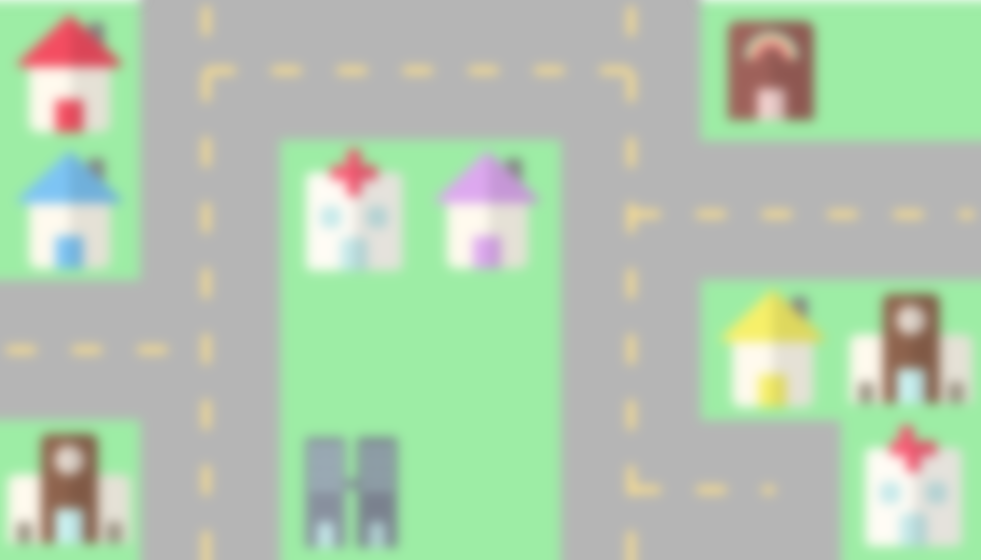

by kurt de leon
cj alcantara
king morales
jordan barro

Slide 2
Description
Goals
Frameworks and Libraries
Missing Features
Recommendations

Slide 3
Description
Goals
Frameworks and Libraries
Missing Features
Recommendations

Slide 4
To include members of the community who are not directly part of the economic growth of the nation (e.g. kids, students, etc.)
To instill a feeling of a crowdsourced charity drive
To create a sustainable source of money for donation
To motivate people to be part of the cause (since they can see the city themselves)
To teach the youth the joy of lending a helping hand :)
GOALS

Slide 5
To include members of the community who are not directly part of the economic growth of the nation (e.g. kids, students, etc.)
To instill a feeling of a crowdsourced charity drive
To create a sustainable source of money for donation
To motivate people to be part of the cause (since they can see the city themselves)
To teach the youth the joy of lending a helping hand :)
GOALS

Slide 6
To include members of the community who are not directly part of the economic growth of the nation (e.g. kids, students, etc.)
To instill a feeling of a crowdsourced charity drive
To create a sustainable source of money for donation
To motivate people to be part of the cause (since they can see the city themselves)
To teach the youth the joy of lending a helping hand :)
GOALS

Slide 7
To include members of the community who are not directly part of the economic growth of the nation (e.g. kids, students, etc.)
To instill a feeling of a crowdsourced charity drive
To create a sustainable source of money for donation
To motivate people to be part of the cause (since they can see the city themselves)
To teach the youth the joy of lending a helping hand :)
GOALS

Slide 8
To include members of the community who are not directly part of the economic growth of the nation (e.g. kids, students, etc.)
To instill a feeling of a crowdsourced charity drive
To create a sustainable source of money for donation
To motivate people to be part of the cause (since they can see the city themselves)
To teach the youth the joy of lending a helping hand :)
GOALS

Slide 9
Description
Goals
Frameworks and Libraries
Missing Features
Recommendations

Slide 10
DataTables (JQuery)
Bootstrap
Django
FRAMEWORKS AND LIBRARIES

Slide 11
Description
Goals
Frameworks and Libraries
Missing Features
Recommendations

Slide 12
Blogs
Support Page
Different types of users (moderator and admin support)
More functional forms (through JavaScript)
Ads
MISSING FEATURES

Slide 13
Description
Goals
Frameworks and Libraries
Missing Features
Recommendations

Slide 14
Aesthetics
Functionality
Better Technology (e.g. 3D Virtual City, fully-coded in JavaScript)
Complete back-end implementation
RECOMMENDATIONS

Slide 15

Blue hacks 2018

